Slide 1


Slide 2
Core activities
Delivery of ITT
Delivery of the new Early Career Framework (ECF)
Provide Appropriate Body (AB) services for Early Career Teachers (ECTs)
Delivery of the newly reformed NPQs
Delivery of other bespoke evidence based CPD
Promote the work of curriculum hubs and research school

Slide 3
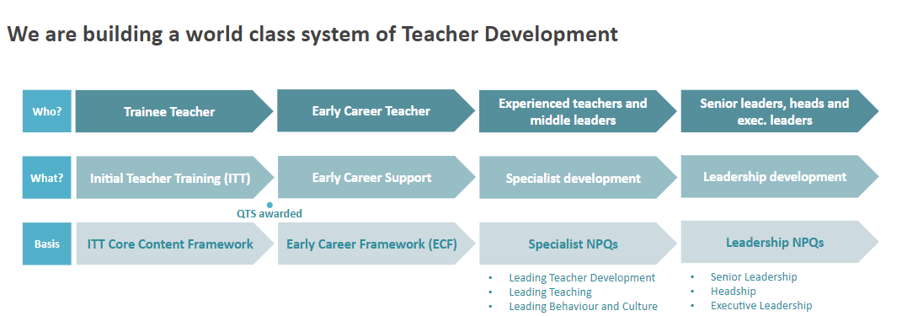

Slide 4
Early Career Framework
2 years of new, funded, high-quality training
funding for 5% time away from the classroom for teachers in their second year
a dedicated mentor and support for these mentors including access to funded high-quality training
funding to cover mentors’ time with the mentee in the second year of teaching

Slide 5
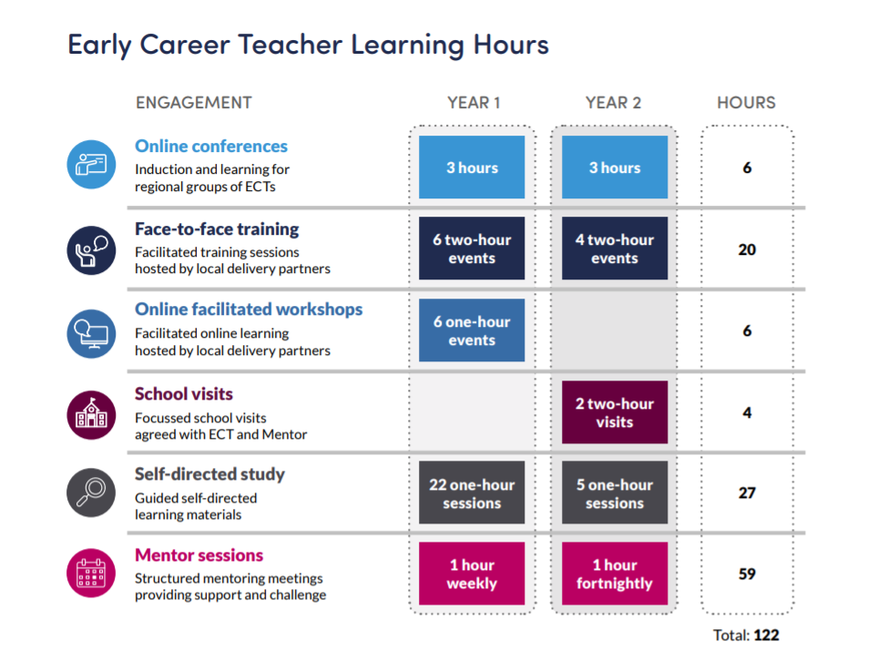

Slide 6
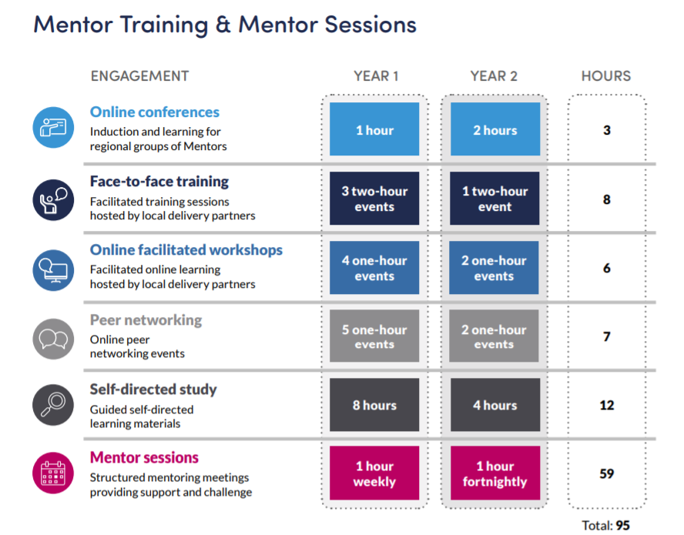

Slide 7
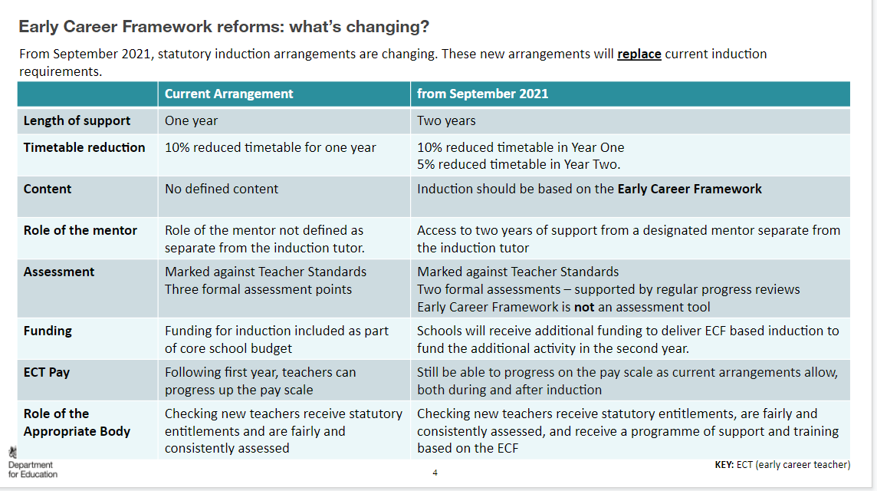

Slide 8
Leadership NPQs
The new specialist NPQs:
Leading Teacher Development: supporting the training and development of others, including early career teachers;
Leading Teaching: developing teachers who are subject leads or responsible for improving teaching practice in a subject or phase; and
Leading Behaviour and Culture: developing teachers who have responsibilities for leading behaviour and culture.
NPQSL
NPQH
NPQEL

